Slide 1
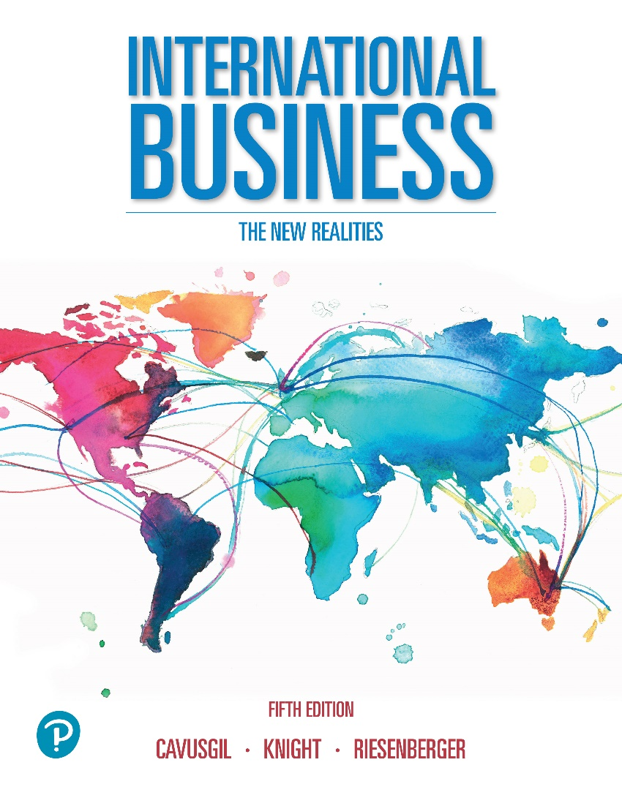
International Business: The New Realities
Fifth Edition
Chapter 8
Understanding Emerging Markets
Slides in this presentation contains hyperlinks. JAWS users should be able to get the list of links by using INSERT+F7
Copyright © 2020 Pearson Education, Inc. All Rights Reserved

Slide 2
Learning Objectives
8.1 Understand advanced economies, developing economies, and emerging markets.
8.2 Know what makes emerging markets attractive for international business.
8.3 Learn how to assess the true potential of emerging markets.
8.4 Evaluate the risks and challenges of emerging markets.
8.5 Learn the success strategies for emerging markets.
8.6 Understand corporate social responsibility, sustainability, and the crisis of global poverty.

Slide 3
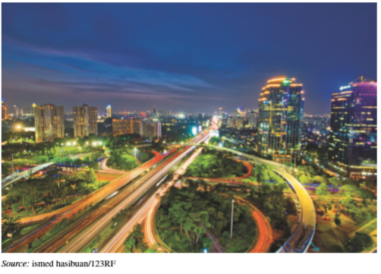
The New Global Challengers (2 of 2)
The New Global Challengers benefit from
Emerging Markets:
  Rapidly growing markets, some of which are large.
  Low-cost labor.
  Training grounds for competing with global incumbents.
  Complex operating
  environments, which
  produce some very
  capable firms.

Slide 4
The New Global Challengers (3 of 3)
1 - What is an emerging market?
2 - What are the characteristics of an emerging market?
3 - What distinguishes an emerging market from an advanced economy (a rich country) and a developing economy?

Slide 5
Key Concepts
Advanced economies: Post-industrial countries with high per capita income, competitive industries, and developed commercial infrastructure. Typically the richest countries, including Australia, Canada, Japan, United States, and nations of Western Europe.
Developing economies: Low-income countries characterized by limited industrialization and stagnant economies. e.g. Bangladesh, Bolivia, Zaire.
Emerging market economies: Former developing economies that achieved substantial industrialization, modernization, and remarkable economic growth. e.g., Indonesia, Mexico, Poland, Turkey.

Slide 6
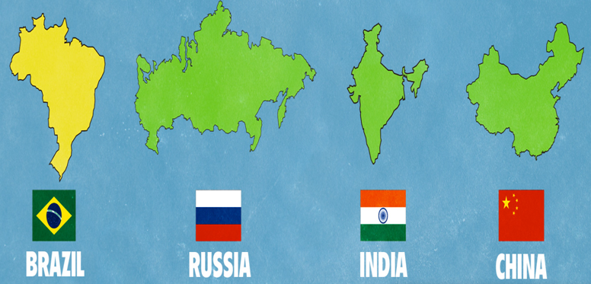
The ‘B R I C’ Countries

Slide 7
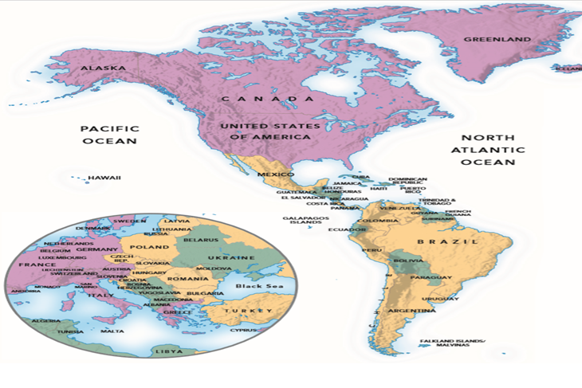

Advanced Economies, Developing Economies, and Emerging Markets (1 of 2)

Slide 8
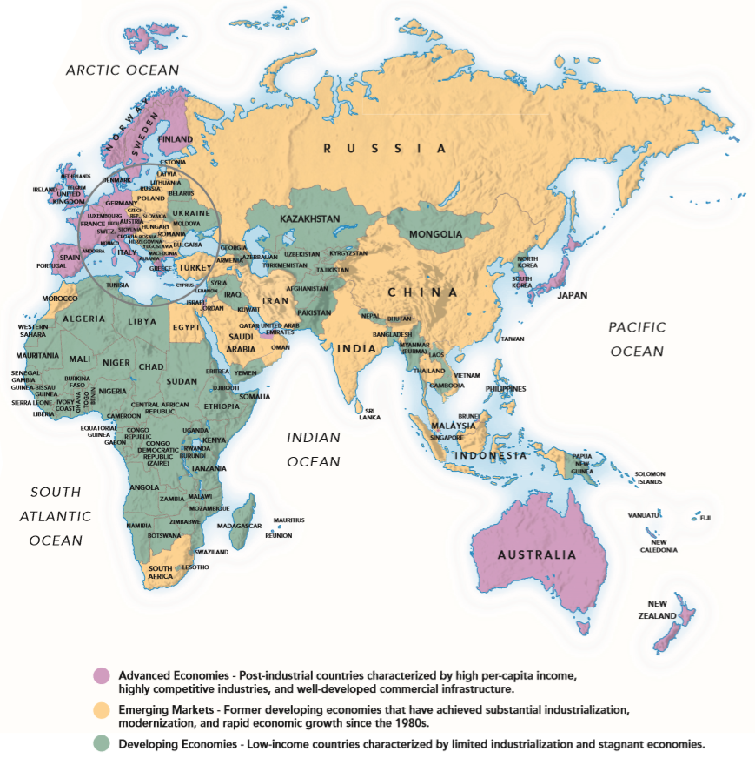
Advanced Economies, Developing Economies, and Emerging Markets (2 of 2)

Slide 9
Key Differences Among the Three Major Country Groups (1 of 2)
Dimension | Advanced Economies | Developing Economies | Emerging Markets
Representative Countries | Canada, France, Japan, U.K., U.S.A. | Angola, Bolivia, Nigeria, Bangladesh | Brazil, China, India, Indonesia, Turkey
Approximate Number of Countries | 35 | 125 | 30
Population (% of world) | 13% | 32% | 55%
Approximate Average Per-Capita Income (U .S. dollars; PPP basis) | $44,400 | $3,650 | $13,830
Approximate Share of World GDP (PPP basis) | 45% | 5% | 50%
Sources: Adapted from World Bank at httpflwvwv.worldbank.org and International Monetary Fund at http://w-wwimf.org.
Notes:
The exhibit shows substantial differences in the economic profiles of the three country groups. In particular, the exhibit reveals that developing economies lack numerous conditions needed for successful economic development, including low trade barriers and substantial international trade and investment. Advanced economies rank well in these areas, and emerging markets are showing consistent improvement.

Slide 10
Key Differences Among the Three Major Country Groups (2 of 2)
Dimension | Advanced Economies | Developing Economies | Emerging Markets
Population (millions) | 1,040 | 2,380 | 4,180
Telephone Lines per 1,000 People (fixed and mobile) | 1,700 | 680 | 1,100
Secure Internet Servers per 1,000,000 People | 1,287 | 12 | 72
Internet Users per 1,000 People | 902 | 365 | 576
Motor vehicles per 1,000 people | 602 | 60 | 230
Sources: Adapted from World Bank at httpflwvwv.worldbank.org and International Monetary Fund at http://w-wwimf.org.

Slide 11
The World at Night
Source: C. Mayhew and R. Simmon (N A S A/G S F C), N O A A/N G D C, D M S P Digital Archive
Notes:
A map of the world at night helps illustrate differences in the level of industrialization among regions of the world. Advanced economies are highly industrialized and enjoy various benefits, including general access to electricity and high-quality infrastructure.

Slide 12

Emerging Market Economies
About 30 countries with rising economic aspirations that enjoy rapidly growing standards of living.
Evolving towards wealthy nation status.
Importance in the world economy is increasing as attractive destinations for exports, F D I, and sourcing.
Hong Kong, Israel, Saudi Arabia, Singapore, South Korea, and Taiwan have developed beyond the emerging market stage.

Slide 13
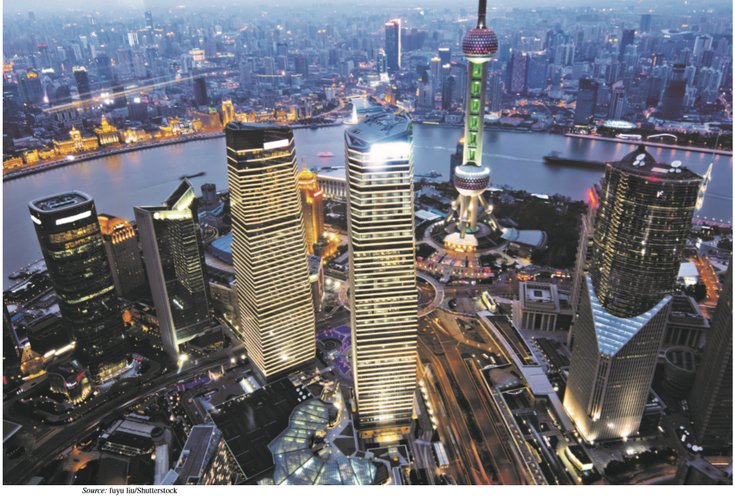
Additional Concepts
Transition economies: A subset of emerging markets that evolved from centrally planned economies into liberalized markets.
Privatization: Transfer of state-owned industries to private concerns.
New global challengers:
Leading firms from emerging
markets that are fast becoming
key contenders in world markets.

Slide 14
Trade Conditions in the Major Country Groups
Trade Condition | Advanced Economies | Developing Economies | Emerging Markets
Industry | Highly developed | Poor | Rapidly improving
Competition | Substantial | Limited | Substantial
Trade Barriers | Minimal | Moderate to high | Moderate
Trade Volume | High | Low | High
Inward FDI | High | Low | Moderate to High
Sources: Based on International Monetary Fund at http://www.imf.org; World Bank, 2018, at http://www.worldbank.org; and Central Intelligence Agency, World Factbook, 2018, https://www.cia.gov/library/publications/the-world-factbook/.

Slide 15
National Characteristics of Major Country Groups
Characteristic | Advanced Economies | Developing Economies | Emerging Markets
Median Age of Citizens | 39 years | 24 years | 32 years
Major Sector Focus | Services, branded products | Agriculture, commodities | Manufacturing, some services
Economic and Political Freedom | Free or mostly free | Mostly repressed | Moderately free or mostly not free
Economic/Political System | Market | Command or Mixed | Mixed
Regulatory Environment | Minimal regulations | Highly regulated, burdensome | Achieved much economic liberalization
Country Risk | Low | moderate to high | Variable
Intellectual Property | Strong | Weak | Moderate and Improving
Infrastructure | Well-developed | Inadequate | Moderate, improving
Sources: Based on International Monetary Fund at http://www.imf.org. and Central Intelligence Agency, World Factbook, 2018, https://www.cia.gov/library/publications/the-world-factbook/.

Slide 16
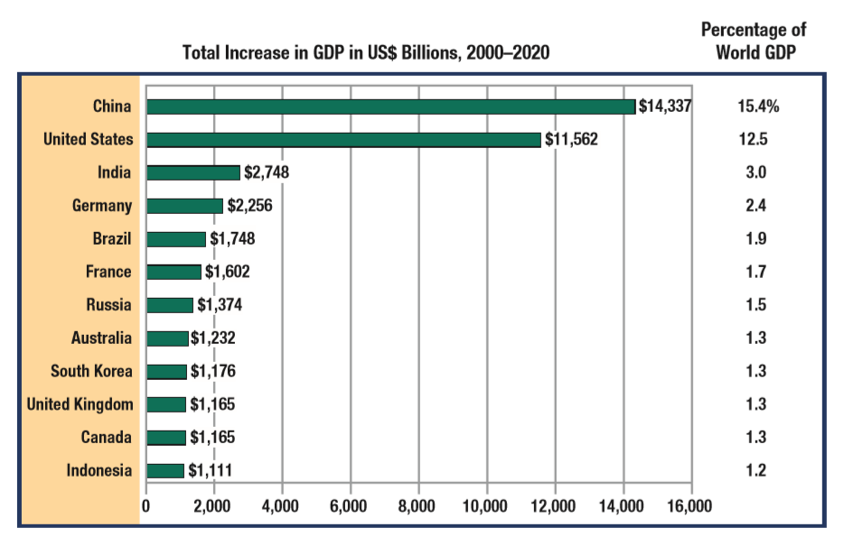
Estimated Total Contribution to World G D P, 2000 through 2020, in Billions of U S Dollars and as a % of World G D P
Source: Based on International Monetary Fund, World Economic Outlook Database, 2018.
Notes:
In purchasing-power terms, emerging markets now account for about half of world GDP. Emerging markets, especially China, India, and Brazil, have contributed enormously to world growth in GDP and will continue to do so in the future. Although advanced economies such as the United States and Europe will remain relatively robust, the emerging markets hold the most promise as target markets and engines of global commerce in the future. In coming decades, it is estimated that the majority of growth in world GDP will come from emerging markets, especially Brazil, Russia, India and China, the BRIC countries. Presently, emerging markets represent more than one-third of world exports and receive more than one-third of world FDI.

Slide 17
Emerging Market Global Challengers
Country | Example Multinational Firms | Representative Industries
Brazil | Brasil Foods, Embraer, Natura Cosmetics | Food Processor, Aerospace, Cosmetics
China | Alibaba Groups, Huawei Technologies, Lenovo Group | E-commerce, Information and communications technology, Computer Technology
India | Bharti Airtel, Infosys, Tata Motors | Telecommunication Services, Technology Consulting, Automotive
Mexico | America Movil, Cemex, Grupo Bimbo | Telecommunication, Building Materials, Baking, Snacks
Russia | Gazprom, Lukoil, Severstal | Natural Gas, Oil, Steel and mining
Turkey | Koc Holding, Sabanci Holding, Yildiz holding | Industrial, Industrial and financial, confectionary
Source: Based on Boston Consulting Group 2014, September 10, “Meet the 2014 BCG Global Challengers.”

Slide 18
China: Growing Role in International Business
Huge population; rapidly growing economy; big importer.
Began pursuing market reforms in the late 1970s.
Achieved explosive economic growth, quadrupling its GDP during the succeeding 30 years.
China is already the world’s second-largest economy, but has poor business infrastructure.
China buys one-third of the world’s coal, cotton, fish, and rice; one-quarter of the world’s steel; and one-half its pork.
But endures serious problems of air, water, and land pollution; has 8 of the world’s top 10 polluted cities.

Slide 19
What Makes Emerging Markets Attractive? (1 of 2)
Emerging Markets as Target Markets
  Many have huge middle classes, with significant income for buying electronics, cars, health care services, and countless other products.
  Many exhibit high economic growth rates.
Emerging Markets as Manufacturing Bases
  Home to low-wage, high-quality labor for manufacturing and assembly operations.
  Large reserves of raw materials and natural resources. e.g., South Africa, Brazil, Russia.

Slide 20
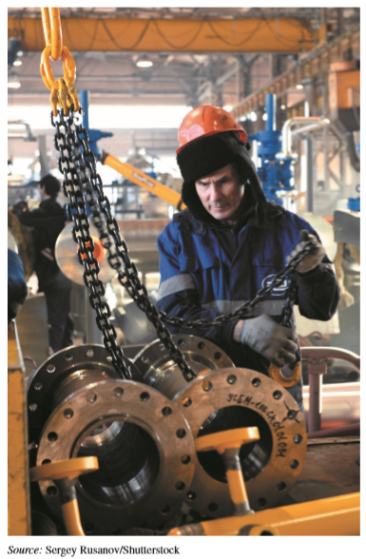
What Makes Emerging Markets Attractive? (2 of 2)
Emerging Markets as Sourcing Destinations
  MNEs have established numerous call
  centers in eastern Europe, India, the
  Philippines, and elsewhere.
  Intel and Microsoft have much of their
  programming activities performed in
  Bangalore, India.
  Investments from abroad benefit
  emerging markets, leading to jobs,
  technology transfer, and linkages
  to the global marketplace.

Slide 21
Key Concepts
Outsourcing: The procurement of selected value-chain activities, including production of intermediate goods or finished products, from independent suppliers.
Global sourcing: The procurement of products or services from independent suppliers or company-owned subsidiaries located abroad for consumption in the home country or a third country.
Purchasing power parity (PPP): An adjustment for prices that reflects the number of goods that consumers can buy in their home country, using their own currency and consistent with their own standard of living.

Slide 22

Estimating the Potential of Emerging Markets
Estimations are challenging because of peculiar economic and social environments in these countries.
Limited availability and reliability of data.
Market research can be very costly and less precise, as compared to the advanced economies.
Market potential indicators include:
-- G D P growth rate
-- income distribution
-- commercial infrastructure
-- unemployment rate
-- consumer expenditures for
discretionary items.

Slide 23
Purchasing Power Parity (PP P)
Adjustment to per capita G D P
In relying on per capita G D P for comparison of different countries, one should use P PP exchange rates, rather than the market exchange rates.
P P P adjustment provides a more realistic indicator of purchasing power of consumers in emerging and developing economies.
P P P adjusted per capita G D P represents the amount of products that consumers can buy in a given country, using their own currency and consistent with their own standard of living.
Notes:
When evaluating the potential of individual markets, managers often start by examining aggregate country data, such as gross national income (GNI) or per-capita GDP, expressed in terms of a reference currency such as the U.S. dollar. However, per-capita GDP converted at market exchange rates paints an inaccurate picture of market potential because it overlooks the substantial price differences between advanced economies and emerging markets. Prices are usually lower for most products and services in emerging markets. For example, a U.S. dollar exchanged and spent in China will buy much more than a dollar spent in the United States. What should managers do to estimate market potential more accurately? The answer lies in using per-capita GDP figures adjusted for price differences. Economists estimate real buying power by calculating GDP statistics based on purchasing power parity (PPP). The PPP concept suggests that, in the long run, exchange rates should move toward levels that would equalize the prices of an identical basket of goods and services in any two countries. Since prices vary greatly among countries, economists adjust ordinary GDP figures for differences in purchasing power. Adjusted per-capita GDP more accurately represents the number of products consumers can buy in a given country, using their own currency and consistent with their own standard of living.

Slide 24
Difference in Per Capita G D P, in Conventional and P P P Terms
Country | Per-Capita GDP, Converted Using Market Exchange Rates | Per-Capita GDP, Converted Using PPP Exchange Rates
Brazil | $10,515 | $15,919
China | 9,377 | 17,943
India | 1,989 | 7,750
Mexico | 10,021 | 20,028
Poland | 15,050 | 30,827
Russia | 10,630 | 28,918
South Africa | 6,292 | 13,591
South Korea | 30,919 | 41,173
Turkey | 11,125 | 27,635
Vietnam | 2,482 | 7,378
United States | 61,687 | 61,687
Source: Based on data from International Monetary Fund, World Economic Outlook Database, 2018 (www.imf.org).

Slide 25
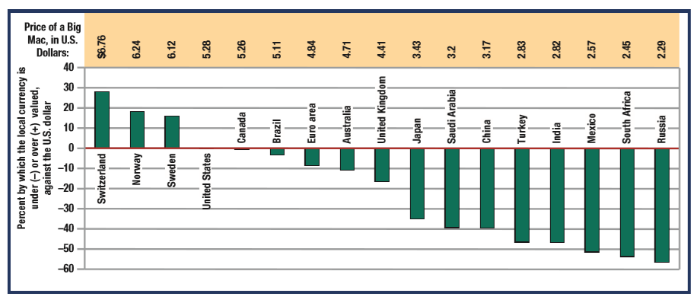
The Big Mac Index
Source: Based on The Economist, “The Big Mac Index,” January 17, 2018, www.economist.com.
Notes:
One way to illustrate the PPP concept is to examine the Big Mac Index developed by The Economist newsmagazine (www.economist.com). The index first gathers information about the price of hamburgers at McDonald’s restaurants worldwide. It then compares the prices based on actual exchange rates to those based on the PPP price of Big Macs to assess whether a nation’s currency is under- or overvalued. Exhibit 8.8 presents the Big Mac Index for the most recent year. It reveals that several currencies in Europe are overvalued, whereas those of emerging markets are undervalued. For example, the index implies that the Chinese yuan and the Russian rouble are substantially undervalued compared to the dollar.17 The Big Mac Index assumes that business costs and McDonald’s strategies are identical across countries. While these assumptions may not be realistic, the index provides a useful approximation of purchasing power and currency valuations around the world.

Slide 26
Median Household Income for a Sample of Emerging Markets
Country | Median Income Per Household (U.S. $)
Brazil | 15,372
China | 9,721
India | 4,965
Indonesia | 5,919
Nigeria | 20,960
Russia | 14,487
Thailand | 7,113
Turkey | 21,966
Sources: Based on United Nations, United Nations Database on Household Size and Composition 2017 (New York: United Nations, 2017); World Bank, “GNI per Capita, Atlas Method (current US$),” 2017, www. data.worldbank.org. Note: Data shown are gross national income per household, Atlas method, in current U.S. dollars.
Notes:
Household income is substantially larger than per capita income in these countries due to the presence of multiple wage earners in individual households. Multiple-income households have much greater spending power than individuals, a fact overlooked by statistics that emphasize per-capita GDP.

Slide 27
Key Criteria for Assessing the Attractiveness of Emerging Markets and Developing Economies
Market Size: The country’s population, especially those living in urban areas.
Market Growth Rate: The country’s real GDP growth rate.
Market Consumption Capacity: Income of the middle class
Commercial Infrastructure: Density of telephone lines, number of personal computers, density of paved roads, population per retail outlet, and other such characteristics.
Economic Freedom: The degree to which government intervenes in business activities.
Country Risk: Degree of political and macroeconomic risk.

Slide 28
Challenges of Doing Business in Emerging Markets (1 of 3)
Political instability – Corruption, weak legal systems, and unreliable government authorities increase business risks and costs, and hinder forecasting.
Weak intellectual property protection – Discourages producing or selling goods that entail valuable assets.
Bureaucracy, red tape, and lack of transparency – Burdensome rules, excessive requirements for licenses, approvals, and paperwork; not accountable legal and political systems. e.g., It may take years, or many bribes, to obtain permissions to do business. China, India, and Russia are particularly problematic.

Slide 29
Challenges of Doing Business in Emerging Markets (2 of 3)
Poor physical infrastructure – Lower quality roads, drainage systems, sewers, and electrical utilities are often a factor in emerging markets. For example, India’s ports, roads, railways, and airports are insufficient to handle the massive volumes of cargo that enter and leave the country every day.
Partner availability and qualifications – MNEs that seek alliances with well-qualified local companies may find such partners in short supply in emerging markets.

Slide 30
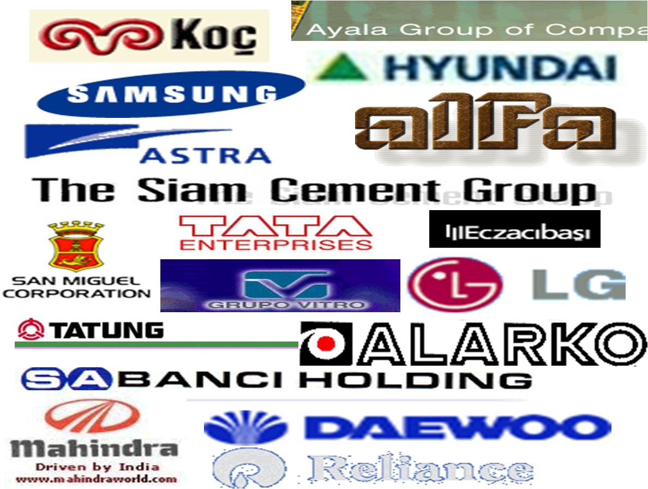
Challenges of Doing Business in Emerging Markets (3 of 3)
Resistance from family conglomerates – Economies may be dominated by privately-owned local firms that are highly diversified, and control supplies and employment. Common in South Korea (chaebols), India (business houses), Latin America (grupos), and Turkey (holding companies).
Notes:
Family conglomerates enjoy various competitive advantages in their home countries, including government protection and support, extensive networks in various industries, superior market knowledge, and access to capital. Hyundai Group was an early mover in South Korea’s auto industry and now holds the largest share of that country’s car market. When foreign automakers tried to enter the market, they found Hyundai’s advantages overwhelming.

Slide 31
Strategies for Doing Business in Emerging Markets (1 of 3)
Customize Offerings to Unique Emerging Market needs. Successful firms develop a deep understanding of the distinctive characteristics of buyers, local suppliers, and distribution channels in emerging markets, and customize offerings and business models accordingly.
Partner with Family Conglomerates – F C s can provide various advantages, including financing, bank services, local suppliers, and distribution channels. F C s can help reduce risks, time, and capital requirements; develop relationships with governments and other key players; and overcome infrastructure hurdles.

Slide 32
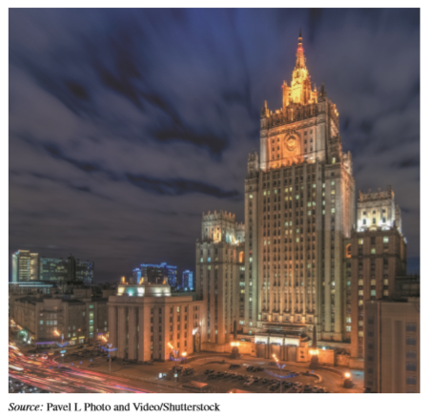
Strategies for Emerging Markets (2 of 3)
Target Governments, which buy enormous quantities of products, such as computers, furniture, office supplies, and motor vehicles, as well as services. State enterprises operate in areas such as railways, airlines, banking, oil, chemicals and steel.
Skillfully Challenge Emerging
Market Competitors. New global
challengers and other emerging
market firms possess various
advantages that require skillful
strategies and due diligence to
overcome.

Slide 33
Strategies for Emerging Markets (3 of 3)
Low-cost labor, skilled workforce, government support, and family conglomerates give emerging market firms various advantages. Advanced economy firms must:
  Conduct research to understand target markets and the indigenous challengers.
  Acquire new capabilities that build competitive advantage (e.g., develop new products, new ways of doing business, local alliances).
  Leverage the same advantages in emerging markets enjoyed by local firms (e.g., low-cost labor, skilled workforce, cheap capital, key partnerships).

Slide 34
You Can Do It: Andrew & Jamie Waskey
(1 of 3)
Andrew and Jamie are married recent graduates who got their master’s degrees in international business at a state university in the United States.
They are making their careers as business managers in Dubai, in the United Arab Emirates.
They have traveled extensively in Europe, Latin America, and the Middle East.
Andrew also worked as a marketing intern at the U S Department of Commerce, in Shanghai, China.
Jamie was a market research intern at U S Department of Commerce, in Buenos Aires, Argentina.

Slide 35

You Can Do It: Andrew & Jamie Waskey (2 of 3)
Success Factors
Set goals and persistently work toward them. If you
want to work abroad, pursue your goal actively.
Know what you want to do.
Develop a clear professional
path.
Leverage friends and other
contacts to connect with key
people in your field.

Slide 36
You Can Do It: Andrew & Jamie Waskey (3 of 3)
Challenges of working abroad
Mastering cross-cultural communication
Adapting to different living situations
Making friends
Striking a healthy work—life balance

Slide 37
Catering to Emerging Market Economic Development Needs
Increasingly, firms are involved in fostering economic development in emerging markets.
Assisting economic development may (or may not) be part of efforts aimed at corporate social responsibility.
More commonly, doing business in emerging markets makes good business sense, and generates big profits.
Helpful ventures include modernization projects (e.g., power plants); infrastructure projects (highways); injections of capital (via microfinance); marketing consumer products (which leads to distribution channels, reduces prices, and creates jobs).
Notes:
Most people in emerging markets and developing economies live in relative poverty. Economic disparity and poverty are critical global challenges. Poverty increases the likelihood of disease, food shortages, terrorism, illicit trade, and international migration. Despite strong growth in emerging markets, many of these nations face cyclical poverty that reduces access to basic social infrastructure such as education, health care, and sanitation. Poverty increases the fragility of national governments.

Slide 38
Foreign Firms Support Local Economic Development
Walmart and Home Depot have created new, cost-effective distribution channels in Mexico.
Unilever and P & G sell shampoo in India for less than $0.02 per mini-sachet.
Cemex provides low-cost building materials to millions of poor people.
Narayana Health sells health insurance for less than $0.20 per person per month in India.
Various cell-phone and telecom firms have substantially increased telecommunications infrastructure in Africa.

Slide 39
Ethical Connections
Africa bears the burden of about one-quarter of all disease worldwide, yet has only 3% of the world’s health care workers. Most Africans cannot obtain medical care.
Every day, thousands die from treatable or preventable ailments such as malaria and A I D S.
M N E s play a growing role to address such challenges.
Private firms such as GlaxoSmithKline and General Electric use innovative business approaches to provide needed medications and medical care to impoverished countries in Africa.
Numerous firms have established clinics that provide low-cost health care.

Slide 40
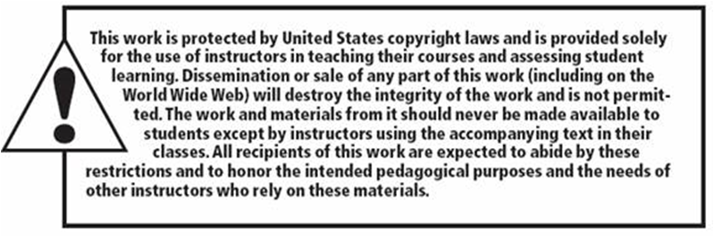
Copyright

